Slide 1



Slide 3
Announcement
Attendance link will be shared at the end of the session
Minimum 25 Days Attendance required to receive your FREE E-CERTIFICATE (with same mobile number & email id)

Slide 4
Prerequisites for this Course
Be ready with sufficient data
Laptop with Good Internet
No basic knowledge is required
Note & Pen

Slide 5


Machine Learning
Overview & Algorithms

Slide 6


Solution - Internship
30 Day Recorded Video Lectures
(₹4000)
20+ Projects
(₹30,000)
Bonus Task, Assignments
(₹1,500)
Technical Material(PPT, Mindmap)
(₹1,000)
Rs.40,000
200 AI Interview Questions
(1500)
Rs.1,999
Certificate For Internship with your Photocopy
(₹2,000)
Daily Live Q&A Session
Lifetime Course Validity

Slide 7
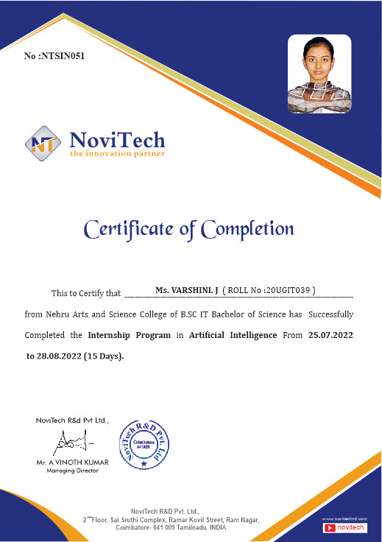

Slide 8
Mindset of the Day
Success usually comes to those who are too busy to be looking for it…

Slide 9

Post Your Attendance

Slide 10




THANK YOU☺
Join our What’s app Community group
novitechresearchanddevelopment

Slide 11
Q & A Session?

